Slide 1
10-6-15 Bellwork:
2. Stewart has always said he is a comedian, not a journalist. So, why do many people trust his comedy show more than some news programs?
3. How does satire on television and in editorial cartoons change the way
people look at politics and news events?
4. Do you think satirists like Stewart increase awareness and participation in politics?
1. Comedian Jon Stewart is planning to leave The Daily Show. What do these cartoons say about his reputation?

Slide 2
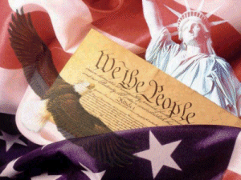
United States Constitution 101
The Constitution

Slide 3
What is the US Constitution?
The supreme law of the United States.
It is the foundation and source of the legal authority underlying the existence of the United States of America and the Federal Government of the United States.
It provides the framework for the organization of the United States Government.

Slide 4
What are the basic principals of the Constitution?
Popular Sovereignty
  Government power resides in the people
Limited government
  Government is not all powerful, can only do what the people let it.
Separation of Powers
  Helps prevent one branch from becoming too powerful
  Checks and Balances
Federalism
  Division of power among national and state governments

Slide 5
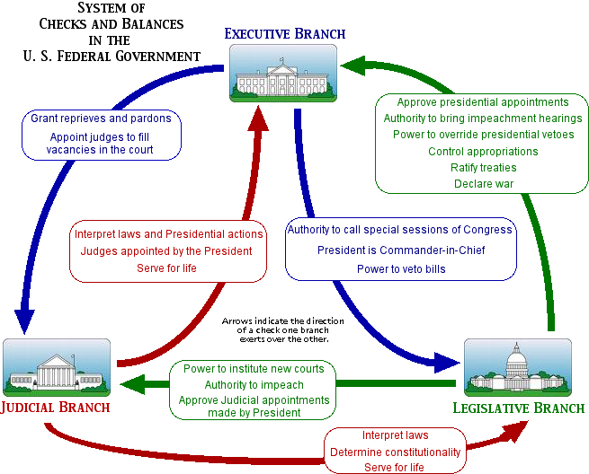
What are the Checks and Balances?

Slide 6
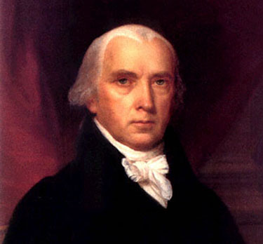
Who Wrote It?
James Madison is considered “the father of the Constitution.”
His important contributions:
  The Virginia Plan
  Separation of Powers
  Bill of Rights

Slide 7
Why was it written?
After the Revolutionary War, the Articles of Confederation set up the structure of the US Government.
The federal government was extremely weak and this created many problems such as:
  No separation of powers – only unicameral legislature.
  Weak central government – states had most power.
  Congress did not have the power to tax – this means they could not get their finances in order.

Slide 8
Why was it written?
More problems with the Articles of Confederation:
  In order to change the Articles, all thirteen states had to approve of the changes. This made it essentially impossible to make any changes.
  For any major laws to pass they had to be approved by 9 or the 13 states which was difficult.
  Congress did not have the power to regulate commerce which caused competition between states. It also caused diplomatic issues when states refused to pay for goods their received from other nations.

Slide 9
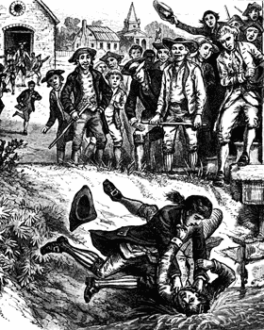
Why was it written?
Shays’ Rebellion:
  An uprising of farmers in Massachusetts – led by Daniel Shays.
  Helped convince leaders that a strong central government was needed.
"A scene at Springfield, during Shay's Rebellion, when the mob attempted to prevent the holding of the Courts of Justice."—E. Benjamin Andrews, 1895

Slide 10
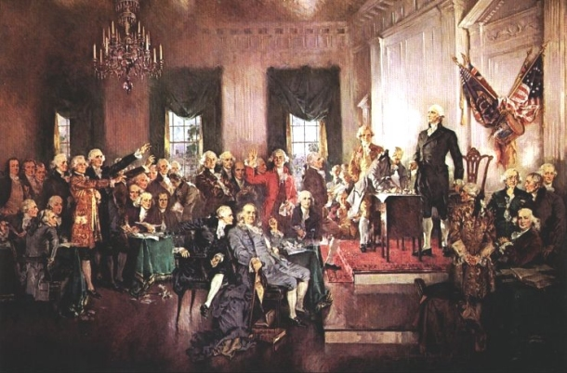
When was it written?
May 25th to September 17th, 1787
Philadelphia
Intention was to revise Articles of Confederation
Ended up replacing the Articles and creating a new government
Called the “Constitutional Convention.”

Slide 11
What were the important outcomes of the Constitutional Convention
Virginia Plan:
  Separation of powers
  Bicameral legislature based on population
  Federal government had increased powers
New Jersey Plan:
  Unicameral legislature where every state received equal representation.
Great Compromise:
  Hybrid of VA and NJ Plans:
    Bicameral legislature:
      House of Reps based on population
      Senate based upon equal representation
  Three-Fifth’s Clause:
    Slaves count as 3/5’s of a person for representation purposes & taxes.

Slide 12
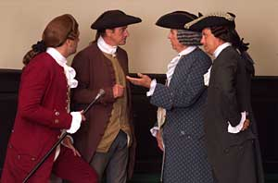
Ratification Debate
Needed 9 of 13 states to ratify or official approve of the Constitution before it went into effect.
A huge debate emerged between two sides:
  Federalists
  Anti-Federalists

Slide 13
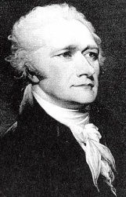
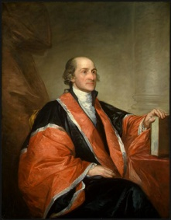
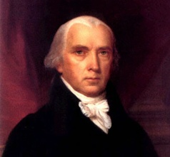
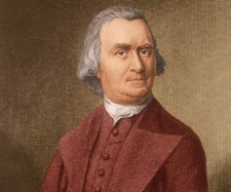
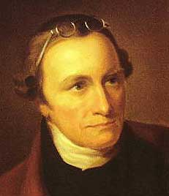
Federalists v. Anti-Federalists
Federalists:
  Supported the Constitution and a strong central government
  Alexander Hamilton, James Madison, John Jay
  Federalist Papers – series of articles written in defense of the Constitution
Anti-Federalists:
  Supported a weaker central government – felt too much power was taken away from the states
  Opposed the Constitution
  Wanted a Bill of Rights included
  Samuel Adams, Patrick Henry

Slide 14
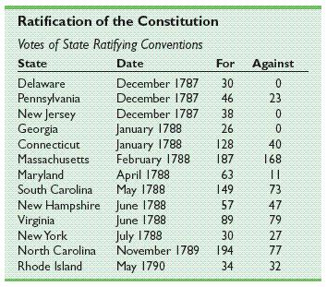
Ratification
Officially adopted after ratified by New Hampshire.
Once the new government convened, they added a Bill of Rights to the Constitution.

Slide 15
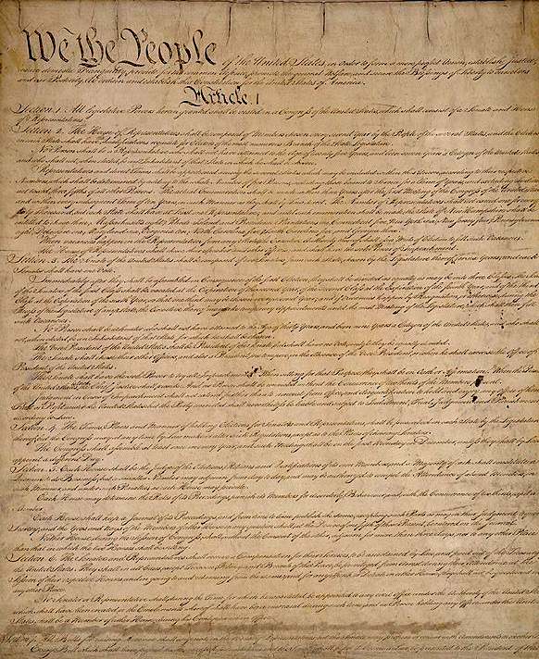
Structure of the Constitution
Preamble:
  Statement of purpose
Articles:
  I: Legislative Branch
  II: Executive Branch
  III: Judicial Branch
  IV: Relations Among the States
  V: Amendment Process
  VI: Federal Power
  VII: Ratification
Amendments:
  27 Total
  1st ten are the Bill of Rights

Slide 16
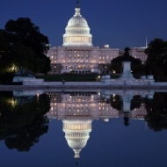

Article I: Legislative Branch
Bicameral:
  Senate
    2 Senators for each state
  House of Representatives
    Based on population
Reps serve for 2 year terms
Senators serve for 6 year terms
Important Powers:
  Make laws
  Set taxes
  Declare war
  Override Vetoes
  Borrow money
  Regulate international and national trade
  Print money

Slide 17
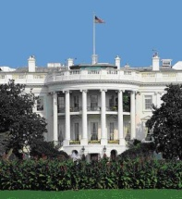

Article II: Executive Branch
President and Vice President are elected to 4 year terms
Qualifications:
  At least 35 years old
  14 year resident of the US
  Natural born citizen
Elected by the Electoral College
Important powers:
  Commander-in-Chief
  Grant pardons
  Make treaties
  Appoint federal officers
  Ensure laws are executed

Slide 18
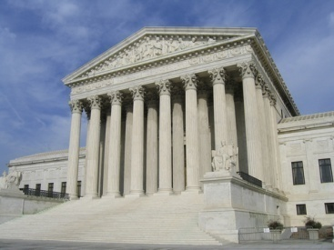

Article III: Judicial Branch
Supreme Court judges serve for life unless impeached.
Judicial power rests with US Supreme Court and other courts created by Congress
Important Powers:
  Decides cases of Constitutional law and federal law
  Cases involving ambassadors go straight to Supreme Court
  Judicial Review comes later (1803 – Marbury v. Madison)

Slide 19
Other Important Articles:
Article V: Amendments:
  Amendments are proposed when 2/3 of House and Senate deem it necessary
  Amendments are proposed when 2/3 of states deem it necessary
  Amendments must be ratified by ¾ of state legislatures or by conventions in ¾ of states
Article VI: Federal Power
  Supremacy Clause: Federal law is supreme to state law
  No religious tests for public office

Slide 20
Important Amendments:
Bill of Rights
Freedom of religion, of speech, of the press, to assemble, and to petition
Right to bear arms
No quartering of soldiers
No unreasonable search and seizure
Indictments; Due process; Self-incrimination; Double jeopardy, and rules for Eminent Domain.
Right to a fair and speedy public trial, Notice of accusations, Confronting one's accuser, Subpoenas, Right to counsel
Right to trial by jury in civil cases
No excessive bail & fines or cruel & unusual punishment
There are other rights not written in the Constitution
All rights not given to Federal Government belong to states and people.

Slide 21
Other Important Amendments:
Reconstruction Amendments
13th Amendment
  abolished slavery
14th Amendment
  Due process and equal protection under the law
  All persons born in US are citizens
15th Amendment
  Right to vote regardless of race, color, or previous servitude

Slide 22
Other Important Amendments:
18th Amendment
  Prohibition of alcohol
19th Amendment:
  Women’s suffrage
21st Amendment:
  Repeals prohibition
22nd Amendment:
  Presidential term limits
24th Amendment:
  Prohibits poll taxes for voting
26th Amendment:
  lowers voting age to 18

Slide 23
1. Open Edmodo and complete review sheet.
2. Remember to study for test tomorrow.

