Slide 1
Indian Empires:
Maurya and Gupta Empires
Cultural Cohesion
1500 B.C.E.-600 C.E.

Slide 2
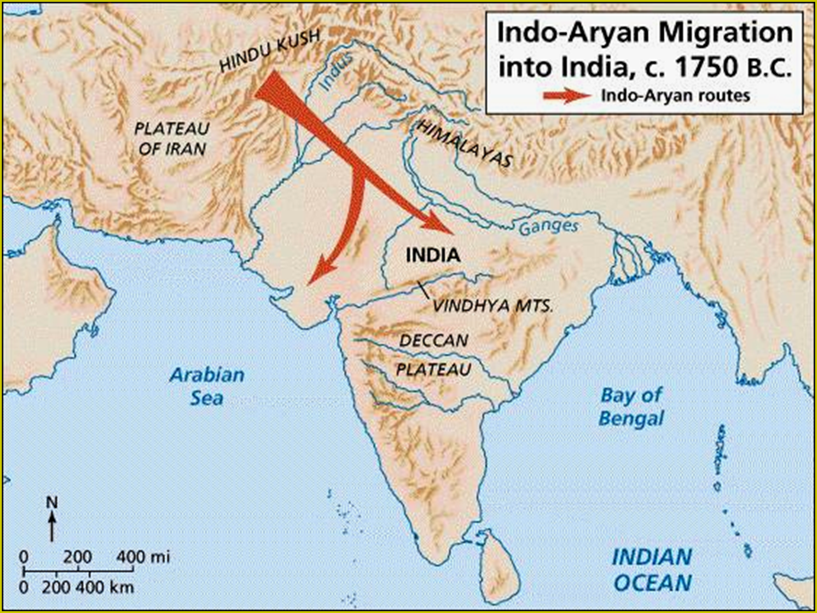
pastoral → depended on their cattle.
warriors → horse-drawn chariots.

Slide 3
Vedic Age: 1500 B.C.E-500 B.C.E.
When the Aryans entered India, they practiced a limited amount of agriculture, but they depended much more heavily on a pastoral economy.
Cattle became the principal measure of wealth in early Aryan Society.*
The early Aryans did not use writing but they composed numerous poems and songs. Their sacred language was Sanskrit.
The earliest of these orally transmitted works were the Vedas, which were collections of songs, prayers, and rituals honoring Aryan gods. It appears there was no chronological record attempt to the writings. [Religious reflections]
The earliest was the Rig Veda, a collection of 1,028 hymns.

Slide 4
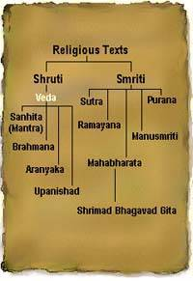
The Vedas
1200 BCE-600 BCE.
written in SANSKRIT.
Hindu core of beliefs:
hymns and poems.
religious prayers.
magical spells.
lists of the gods and goddesses.
Rig Veda → oldest work.

Slide 5
The Aryans and India
After 1000 B.C.E., they began to settle the area between the Himalayan foothills and the Ganges river. During this time iron tools and implements were being made.
Although they did not build a large-scale political structure, the Aryans constructed a well-defined social order.
The Aryan social structure rested on sharp hereditary distinctions between individuals and groups according to their occupations and roles in society.
In addition, small kingdoms began to appear and it appears that continual warfare between kingdoms was common.

Slide 6
Caste and Varna
Caste identities developed gradually as the Aryans established settlements throughout India.
The Aryans used the term Varna (Color) to refer to the major social classes. “Wheat colored v. darker skinned”
After about 1000 B.C.E., the Aryans increasingly recognized four main Varnas: Brahmins (priests), kshatriyas (warriors and aristocrats), vaishyas (cultivators, merchants, artisans), and shudras (landless peasants and serfs). Untouchables came later
Dravidians believed that humans souls took on new physical forms after deaths of their bodily hosts. Sometimes souls returned as plants or animals, sometimes in the bodily shell of newborn humans.
Transmigration and reincarnation

Slide 7
Varna (Social Hierarchy)
Brahmins
Kshatriyas
Vaishyas
Shudras
Pariahs [Harijan] → Untouchables

Slide 8
The Vedic Age
The foundations for Hinduism were established!

Slide 9
The Empires of India
Establishment of States

Slide 10
Fortunes of Empire in India
By 700 B.C.E., wars of expansion had resulted in consolidation of several large regional kingdoms that dominated much of the subcontinent.
However, none of these earlier kingdoms were able to establish hegemony over the others.
During the classical era, the Mauryan and the Gupta Dynasties founded centralized, imperial states that embraced much of India, but neither empire survived long enough to establish centralized rule as a lasting feature of Indian life.

Slide 11
Unification of India
The strive for unification of India came partly as a result of intrusion from beyond the subcontinent.
About 520 B.C.E. the Persian emperor Darius crossed the Hindu Kush, conquered parts of NW India, and made what is now Punjab in northern Pakistan part of the Achaemenid Empire. Persian ways were embraced.
Almost two centuries later in 327 B.C.E., after overrunning the Persian empire, Alexander of Macedon crossed the Indus River and crushed the state he found there.

Slide 12
Mauryan Empire
Alexander and his armies did not stay in NW India and his withdrawal created a vacuum by removing the existing states.
During the late 320’s B.C.E., an ambitious adventurer named Chandragupta Maurya exploited that opportunity and laid the foundations for the Mauryan Empire, the first state to bring a centralized and unified government to most of the subcontinent.
He also continued on and capture the Bactrian lands and eventually all of northern India from the Indus to the Ganges.

Slide 13
Maurya Empire
321 B.C.E.- 185 B.C.E.

Slide 14
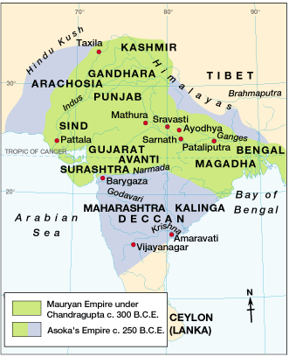
The Maurya Empire
321 BCE – 185 BCE

Slide 15
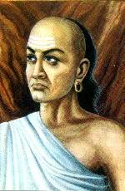
Kautilya
Chandragupta’s advisor.
Brahmin caste.
Wrote The Treatise on Material Gain or the Arthashastra.
A guide for the king and his ministers:
Supports royal power.
The great evil in society is anarchy.
Therefore, a single authority is needed to employ force when necessary!

Slide 16
Succession
Tradition holds that Chandragupta abdicated his throne to become a monk and eventually starved himself to death.
Whether this is true or not, it is certain that his son succeeded him in 297 B.C.E. and added most of southern India to the growing empire.
The high point of the Mauryan Empire came during the reign of Chandragupta’s grandson, Asoka.

Slide 17
Asoka’s reign (268-232 B.C.E.)
Asoka’s first major undertaking was to conquer a region of east-central India known as Kalinga.
By Asoka’s estimate 100,000 died and over 150,000 were removed from their lands.
Some scholars debate that because of the bloody campaign, Asoka converted to Buddhsim.

Slide 18
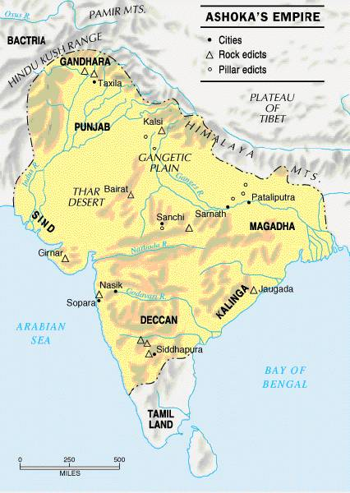
Asoka’s Empire based in Sarnath

Slide 19
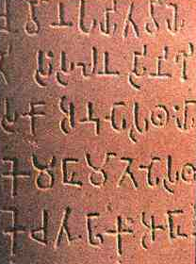
Asoka’s law code
Edicts scattered in more than 30 places in India, Nepal, Pakistan, & Afghanistan.
Written mostly in Sanskrit, but one was in Greek and Aramaic.
10 rock edicts.
Each pillar [stupa] is 40’-50’ high.
Buddhist principles dominate his laws.

Slide 20
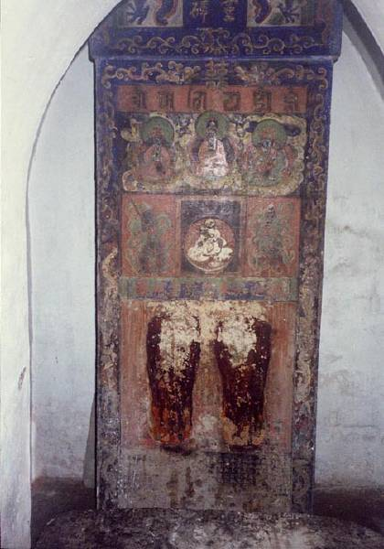
One of Asoka’sStupas

Slide 21
Asoka’s rule
As a result of Asoka’s policies, most of India was integrated and benefited from an expanding economy and a stable government.
He encouraged trade by building roads, some over 1000 miles long, to link India to the West. Along the roads trees were planted, wells were dug, and inns were established.
Asoka died in 232 B.C.E. and decline set in almost immediately. Many scholars believe the excessive pay and costs of administration helped to pave the way and by 185 B.C.E., the Mauryan Empire had disappeared.

Slide 22
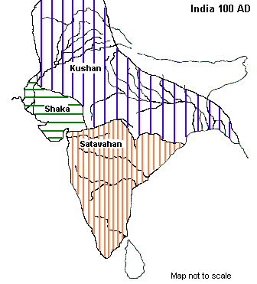
Turmoil & a power Vacuum: 220 BCE – 320 CE
The Maurya Empire is divided into many kingdoms.

Slide 23
Transition
Although the Mauryan Empire came to an end, India did not crumble into anarchy. Regional kingdoms emerged most notably were the Bactrians and the Kushans.
The Indo-Greek Bactrian nomads controlled a large territory in northern India. Bactria was a thriving commercial center linking lands from China to the west.
This region became a cultural crossroads of the now emerging silk road. Most notably was the Bamiyan Valley in modern-day Afghanistan.

Slide 24
The Kushan Empire
The Kushans eventually conquered the Bactrians and ruled much of northern India and central Asia from about 1C.E. to 300 C.E.
Under Kanishka, the most prominent of the Kushan emperors, commerce resumed and the silk road network again flowed between Persia and China, but imperial rule was not established.

Slide 25
The Gupta Empire
320 C.E.- 647 C.E.

Slide 26
The Gupta Dynasty
Like the Mauryas, the Guptas based their state in the center of northern India near the Ganges.
The new empire arose on the foundations laid by Chandra Gupta (Not related to Chandragupta Maurya) who established a kingdom around the year 320 C.E.
His successors, Samundra Gupta and Chandra Gupta II conquered many of the regional kingdoms of India and established tributary alliances.

Slide 27
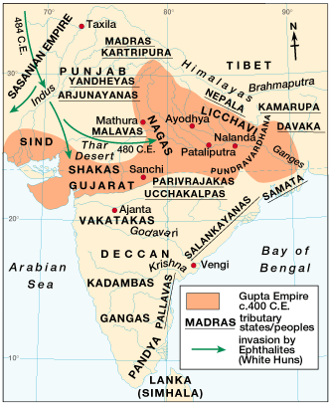
Gupta Empire: 320 CE – 647 CE

Slide 28
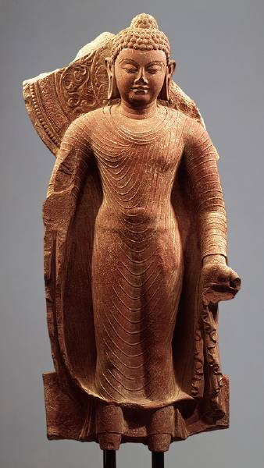
Gupta Rulers
Chandra Gupta I
r. 320 – 335 CE
“Great King of Kings”
Chandra Gupta II
r. 375 - 415 CE
Profitable trade with the Mediterranean world!
Hindu revival.
Huns invade – 450 CE

Slide 29
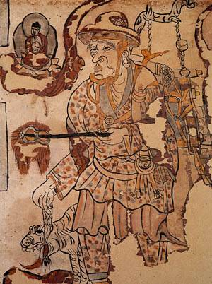
Fa-Hsien: Life in Gupta India
Chinese Buddhist monk traveled along the Silk Road and visited India in the 5c.
He was following the path of the Buddha.
He reported the people to be happy, relatively free of government oppression, and inclined towards courtesy and charity. Other references in the journal, however, indicate that the caste system was rapidly assuming its basic features, including "untouchability," the social isolation of a lowest class that is doomed to menial labor.

Slide 30
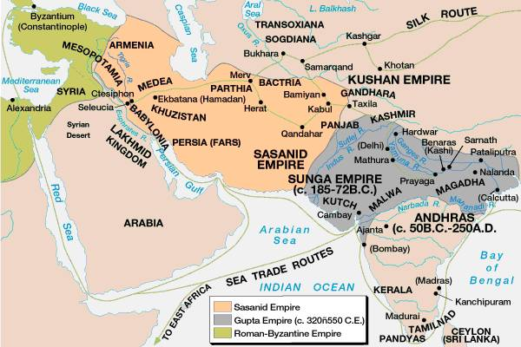
Trade Routes during the Guptas

Slide 31
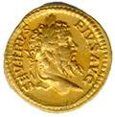
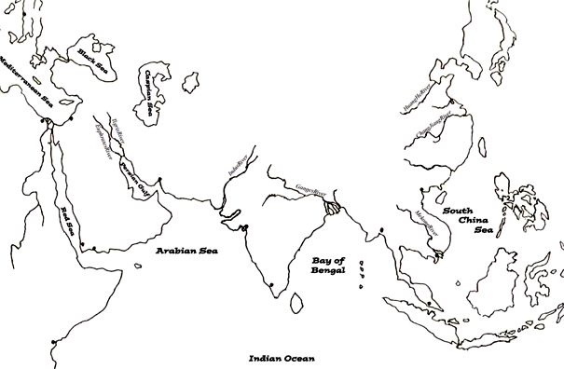
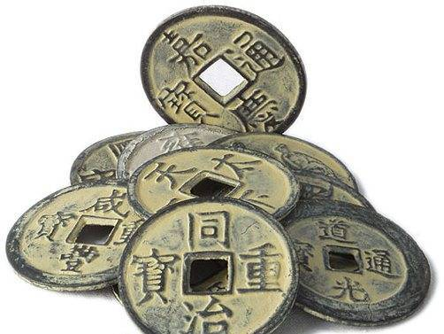
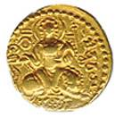
Extensive Trade
spices
silks
cotton goods
rice & wheat
spices
horses
gold & ivory
gold & ivory
cotton goods

Slide 32
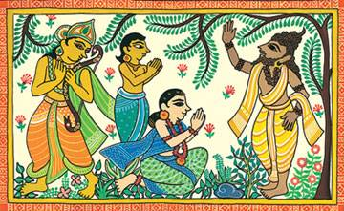
Kalidasa
The greatest of Indian poets.
His most famous play was Shakuntala.
During the reign of Chandra Gupta II.

Slide 33
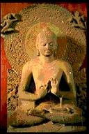
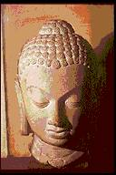
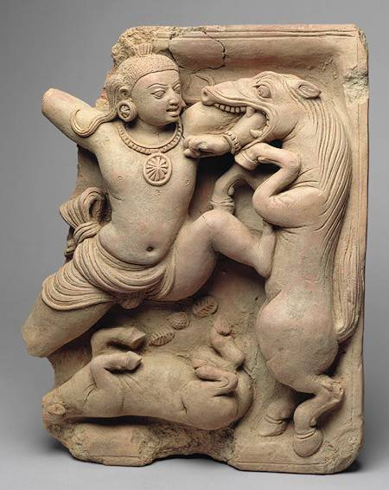
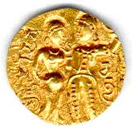
Gupta Art
Greatly influenced Southeast Asian art & architecture.

Slide 34
Gupta Achievement
1000 diseases classified
500 healing plants identified
Printed medicinal guides
Kalidasa
Plastic Surgery
Medicine
Literature
Inoculations
Gupta India
C-sections performed
Solar Calendar
Astronomy
Mathematics
Decimal System
The earth is round
Concept of Zero
PI = 3.1416

Slide 35
Gupta Decline
Unlike Asoka and the Mauryan,the Gupta left local government, administration, and policy in the hands of their allies.
When nomadic invaders came in during the fifth century, it split easily along administrative regions.
Gupta administrative talents were not a match for the White Huns, a nomadic people of Central Asia who occupied Bactria and eventually moved south across the Hindu Kush.
Imperial government survived only a short time in India. India would be overtaken by Muslim groups in the 7 century but not until the establishment of the Mughal Dynasty in the 16 century did any state rule as much of India as the Mauryan or the Gupta.

Slide 36
Jainism and Buddhism
During the Vedic period, people who reacted against the rigid social hierarchy and against the religious monopoly of the Brahmins would withdraw into the forests where they pursued salvation through yoga (spiritual and mental discipline), special diets, or meditation
Their goal was to achieve moksha—liberation from the cycle of birth, death, and rebirth or reaching the best karma that you could actually reach.
The ideas of these religious dissidents are reflected in the Upanishads.

Slide 37
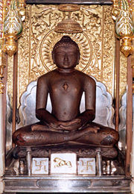
Jainism
Jainism was founded by Mahavira (540–468 b.c.e.).
Jains practiced nonviolence and went to extremes in their attempts not to kill any living thing
The most extreme went naked and starved themselves to death.
The less extreme devoted themselves to commerce and banking—occupations that, unlike agriculture, do not require one to kill.

Slide 38
Buddhism
Siddhartha Gautama founded Buddhism
His title, “Buddha,” means “Enlightened One.”
Alienated by both the extremes of a wealthy youth and six years of asceticism, Siddhartha Gautama set forth his teaching of the “Four Noble Truths” and of the Eightfold Path that would lead the individual to enlightenment.
The First Noble Truth is that old age, illness, and death are all forms of human suffering, and that there are many other ways in which people suffer.
The Second Noble Truth is that suffering is closely linked to desire, a desire for being which leads from birth to death and involve ageing, illness, and mortality. There are also various desires for pleasures and for powers which, frustratingly, may not be realized.
The Third Noble Truth is that suffering can be dispelled by the abandonment of all desires.
The last of the Four Noble Truths holds that such abandonment of desires can be achieved by following the Noble Eightfold Path

Slide 39
Some of his followers took vows of celibacy, nonviolence, and poverty.
The original form of Buddhism centered on the individual’s attempts to gain enlightenment through moderate living, self-discipline, and meditation
Their goal was to achieve nirvana—release from the cycle of birth, death, and rebirth.

Slide 40
According to Buddhist teaching, all things are composite, including the individual
This stands in contrast to the Vedic belief in the existence of an eternal soul (atman).
After the death of the Buddha, some of his followers organized themselves into monasteries and nunneries
They developed a complex, hierarchical religion, complete with worship of the Buddha, reverence for bodhisattvas (people trying to gain enlightenment), and artistic representations of the Buddha.

Slide 41
The religion broke into two major schools: Mahayana and Theravada.
Mahayana incorporated the new beliefs, while Theravada followed the original teaching of the Buddha more closely.

